Slide 1
Emotion Detection from GoEmotions Dataset Using BERT and Data Visualization
By Gopalakrishnan Kumar, MTech IIT-Bombay,
Freelance Data Science Consultant
LinkedIn: Profile Link : https://www.linkedin.com/in/gopalakrishnankumar-a73301110/
Github:https://www.github.com/Gopalakrishnan-Kumar/
Kaggle URL- https://www.kaggle.com/gopalkk2

Slide 2
Google Colab URL
https://colab.research.google.com/drive/18PLoj9us2c0792q5FX7oVpmhU2evb0lQ?usp=sharing

Slide 3
Objective
The primary goal of this project is to build a multi-label text classification model that can detect emotions from short text inputs (e.g., Reddit comments) using BERT, and to analyze the dataset using various visualization techniques to understand emotional distributions, co-occurrence patterns, and correlations.

Slide 4
Dataset Description – GoEmotions
Source: Google Research Accessed via: Hugging Face Datasets or GitHub
🧾 Dataset Characteristics:
58,000+ Reddit comments
27 distinct emotions + neutral
Multi-label format: Each text may have 1–3 labels
Emotions include: joy, anger, curiosity, love, disappointment, etc.

Slide 5
Data Preprocessing
Steps:
Converted label indices to emotion strings using emotions.txt
Parsed label_names column as a list
Applied MultiLabelBinarizer to convert emotions to a binary matrix (multi-label classification)
Tokenized text column using bert-base-uncased
Created PyTorch-compatible dataset class with input tensors and labels

Slide 6
Model
Transformer Used: BERT (bert-base-uncased)
Fine-tuned using Hugging Face Trainer API.
Model Configuration:
Loss Function: BCEWithLogitsLoss (for multi-label)
Activation: Sigmoid (for probability output)
Evaluation Metrics: Accuracy, Micro F1-Score

Slide 7
Training
Training Epochs: 2–3
Batch Size: 8
Optimizer: AdamW
Evaluation Strategy: After each epoch
Metric Logging: via Trainer.state.log_history

Slide 8
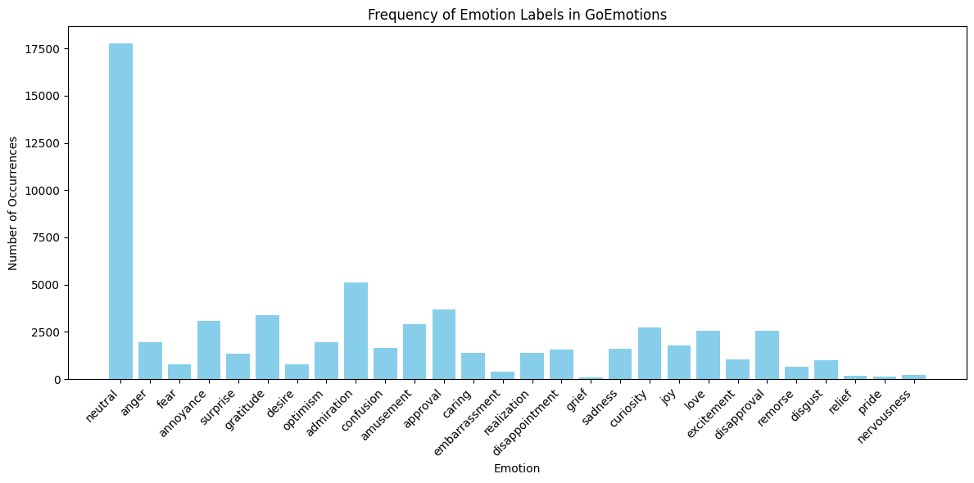
Data Visualizations

Slide 9
Results
Metric | Value
Accuracy | ~85% (top-k match)
Micro F1 | ~0.79
Loss | Decreased over epochs
Prediction | Model correctly identifies overlapping emotions (e.g., joy + gratitude)

Slide 10
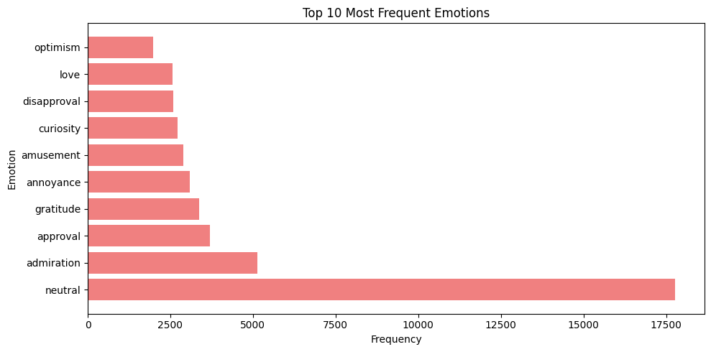
Data Visualizations

Slide 11
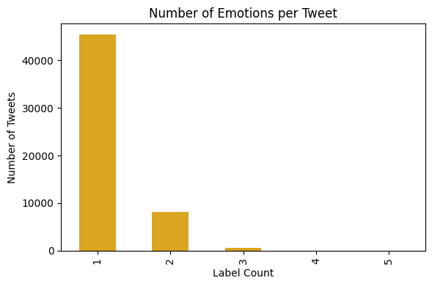
Data Visualizations

Slide 12
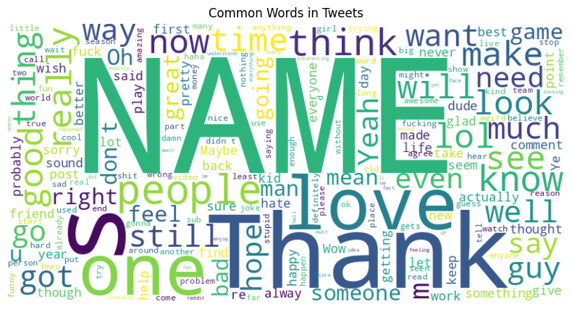
Data Visualizations

Slide 13
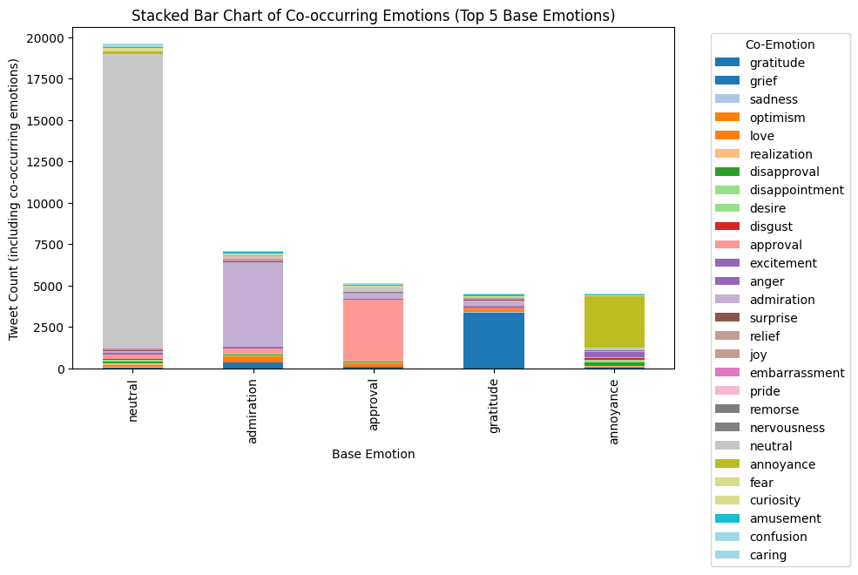
Data Visualizations

Slide 14
Insights
joy, approval, and gratitude are the most common positive emotions.
anger, disappointment, and annoyance dominate the negative class.
Most Reddit comments reflect a single dominant emotion, but some express complex emotional states.

Slide 15
Future Work
Incorporate data augmentation to balance underrepresented classes.
Add attention visualization to explain why BERT makes specific predictions.
Deploy as a web app using Streamlit for real-time emotion detection.
Compare with DistilBERT, RoBERTa, or LSTM-based baselines.

Slide 16
Conclusion
This project demonstrated how BERT, fine-tuned on the GoEmotions dataset, can accurately detect complex emotional cues in short text. The rich emotional annotations and multi-label format provide a powerful benchmark for real-world emotion detection tasks in chatbots, content moderation, and mental health tools.

